Slide 1
INTRODUCTION TO DEVELOPMENT
- MNNIT CC CLUB

Slide 2
CONTENTS
Introduction
Frontend Vs Backend Development
Common Terms
Version Control Systems (VCS)
IDEs
Database
Helping Hands
HomeWork

Slide 3
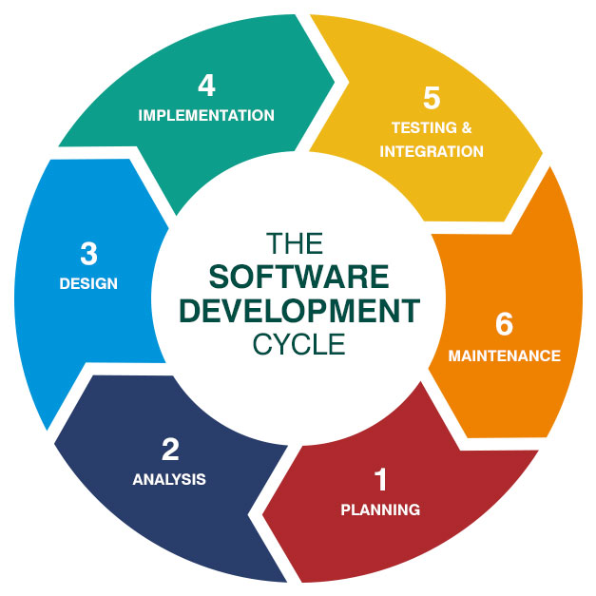
INTRODUCTION
Development in Computer Science refers to a set of activities dedicated to the process of creating, designing, deploying and supporting applications and services.
There are various domains to explore under the development activity,
Web Development
Software Development
Application Development (Android)

Slide 4
REASONS TO START DEVELOPMENT
Development is fun.
While development ,you’ll be put computer science fundamentals into practice.
Development is your lab, you can try out different things with no risk (in most cases).
You can build anything ,ranging from your personal game to a solution that may end world hunger.
You’ll learn teamwork and collaboration skills.
Couple of good projects , sets apart your resume.

Slide 5
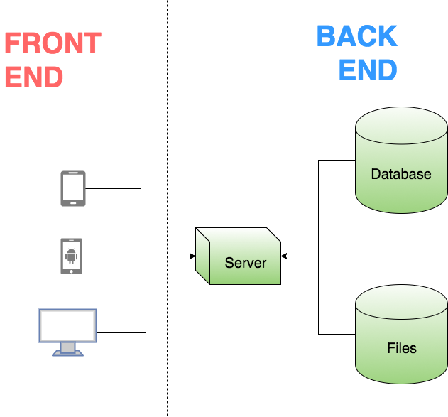
FRONTEND VS BACKEND
Frontend development entails working on customer-facing features, such as web page or an iOS/Android app.
In simple words, it is the user interface of an application.
Roadmap
Backend development involves a layer which maintains the data within a web service with database.
In simple words, it is the server which serves the user application.
Roadmap

Slide 6
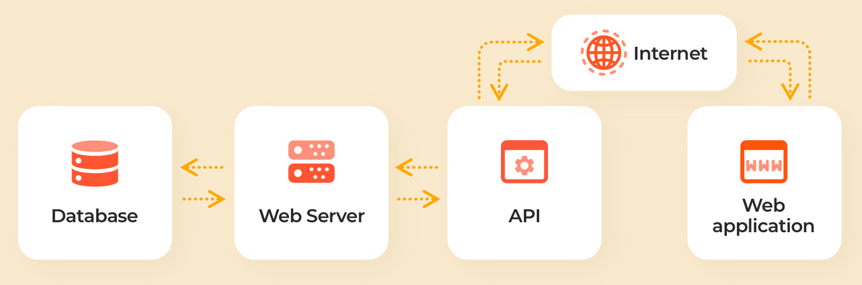
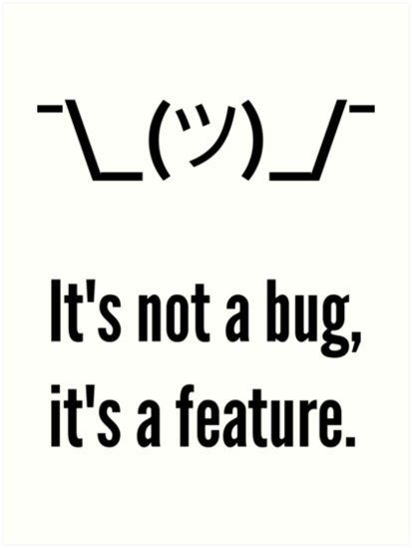
COMMON TERMS
API or Application Programming Interface is a medium through which two or more programs, running on different machines, communicate with each other.
A Bug is an error in a computer program that prevents the program from running as expected.
Open Source software is software with source code that anyone can inspect, modify and enhance. There are many famous open source events such as GSOC etc. Example – Linux, Mozilla Firefox etc.

Slide 7

VERSION CONTROL SYSTEM
Version Control System is a class of software which is used to track and manage changes to software code.
It enhances the project development speed and helps in recovery in case of any disaster or contingent situation.
Eg. Git
Resources :-
Version Control with Git – Udacity
Visualising Branches in Git - Link
Pro Git - Book

Slide 8


INTEGRATED DEVELOPMENT ENVIRONMENTS
IDEs are software for building applications that combines common develop tools into a single graphical user interface. Eg. VS Code.
Text Editor is a software used to create, open and edit text files. Eg. Notepad.
IDEs = Text Editor + Other Developer Tools (formatters, linters etc.)
Examples of widely used IDEs are – Jupyter, Notebook VS Code, Sublime Text, Atom IntelliJ etc.

Slide 9
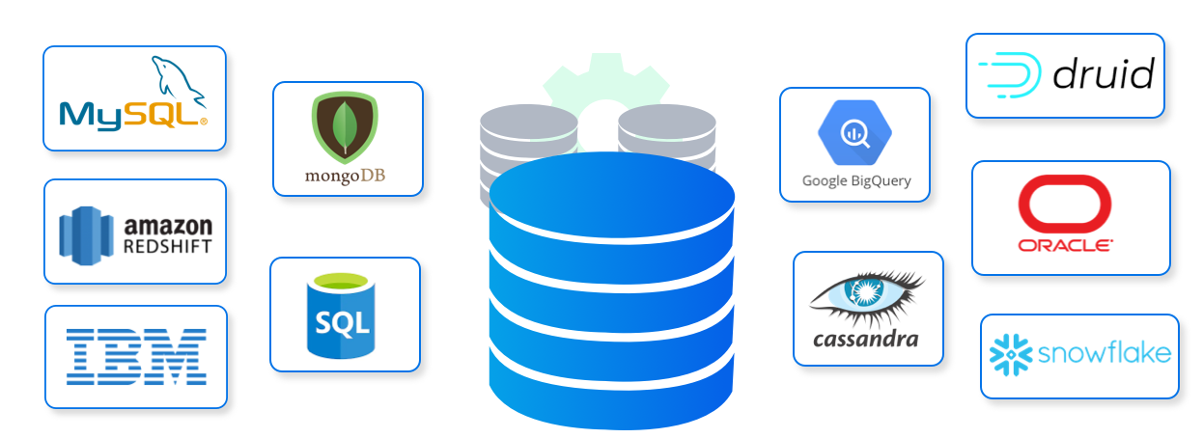
DATABASE
A database is an organised collection of structured information, or data stored electronically in a computer system.
A Database Management System is a software for creating and managing databases.
Two major categories of databases used are
Relational Databases like MySQL etc.
Non-Relational Databases like MongoDB etc.

Slide 10




HELPING HANDS
Performing an accurate google search for the problem is a useful skill while development activity, which takes practice to master.
There are discussion forums like stack-overflow and github threads where you can find solutions to any code related problems by other developers in the community.
There are useful blog sites such as medium or dev.to which contain useful articles to understand and implement tricky procedures and concepts.

Slide 11
HOMEWORK
Follow CC FB group and check it out regularly for updates.
Join Team of CC on MS Teams with given code: ea6m9si.
Follow CC Github, explore and learn going through previous repositories.
Checkout and explore anything new and share with your peers, remember knowledge is the only that increase by sharing among other.
After every class, few tasks will be assigned ,which can be found out in Github Repository 2022-23 for that respective knowledge transfer session

Slide 12
THANK YOU

